Slide 1

Credit card approval PREDICTION
BINARY CLASSIFICATION
Machine learning portfolio
DEREK RODRIGO SÁNCHEZ SEGUAME

Slide 2
done
Task Definition
EDA
Model and Results

Slide 3
done
01
Task Definition

Slide 4
done
Task Definition
Problem statement | MEDICAL PREMIUM CHARGE
SaludVital Analytics is the advanced-analytics division of a leading Mexican health insurer that underwrites policies for individuals and families across middle- and upper-income segments. Leveraging an extensive distribution network and product portfolio, the insurer has achieved strong premium growth but now faces claim costs that are rising faster than actuarial forecasts.
To address this, we will implement a machine-learning–powered predictive engine using the Medical Charges dataset, which includes age, sex, region, BMI, smoking status, number of dependents and actual annual medical charges. By applying sophisticated regression models and robust feature selection, the project will refine premium pricing to align rates with predicted claim costs. It will also optimize reserve adequacy and regulatory capital planning through more precise loss forecasts. Additionally, the engine will identify high-cost segments for targeted wellness programs and personalized member engagement—enhancing underwriting profitability and strengthening the insurer’s competitive positioning in Mexico’s health-insurance market.
4

Slide 5



done
Task Definition
Medicine and data | medical management powered by predictive models
Business Context
The Problem
Solution
The client, SaludVital is the analytics division of a Mexican insurer
Their target market are families across middle and upper income segments
Due to the insurer’s extensive distribution network and portfolio, they’ve achived significant premium growth
The downside: they are facing claims costs higher than expected
We will implement a Machine Learning Model to refine premium predictions to ensure fair pricing and a sustainable business model
By applying an advanced Regression Model, premium costs will be aligned with claim costs

Slide 6
done
02
Exploratory Data Analysis

Slide 7
Overview | an unbalanced target variable
EXPLORATORY DATA ANALYSIS
WIP
# of Features | By data type
# of Categorical Features | By # of unique observations
 | #Features
Numerical | 11
Categorical | 8
Total | 19
 | Two Unique Obs | Three to five Unique Obs | Five+ Unique Obs
#Features | 3 | 3 | 2
Categorical Features Distributions
Target
Features
Churn
Gender
House Owner
Education
Occupation
Note:
7

Slide 8
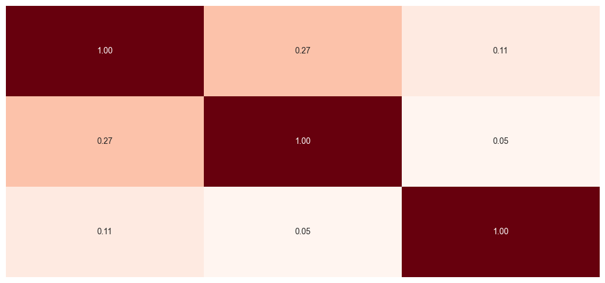
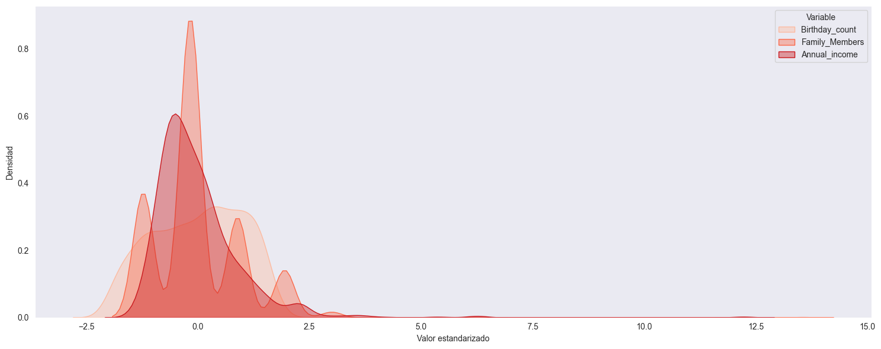
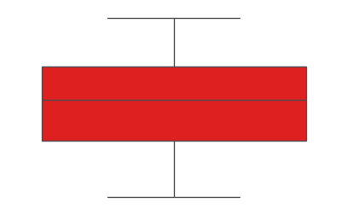
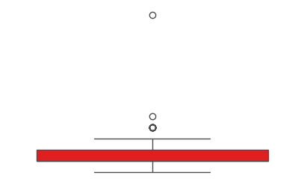
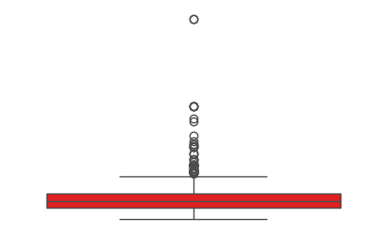
Numerical variables | heatmap, distributions and boxplots
EXPLORATORY DATA ANALYSIS
WIP
Correlation Matrix Heatmap
Distribution Graph
Age
Family members
Income
Age
Family members
Income
Box plot | by feature
Age
Family Members
Annual Income
8

Slide 9
done
03
Model Selection and Results

Slide 10



done
Model selection and results
Model selection | Random forest performed the best in R2 score; optimal for claim prediction
Linear Regression
Support Vector
Random Forest
Gradient Boosting
Tuning: Grid Search
Tuning: Grid Search
Tuning: Randomized Search
Tuning: Randomized Search
Parameters
Fit_intercept: True
Parameters
C: 10
Kernel: poly
Gamma: 1.1
Degree: 5
Parameters
N_estimators: 364
Max_Depth: 5
Min_sample_Split: 4
Min_sample_leaf: 12
Parameters
learning_rate: 0.16
N_estimators: 103
Max_Depth: 3
Subsample: 0.9
Metrics
R2: 82%
MAPE: 53%
Metrics
R2: 87%
MAPE: 11%
Metrics
R2: 91%
MAPE: 29%
Metrics
R2: 82%
MAPE: 53%

Slide 11


Results
DATA SOLUTIONS FOR OPTIMAL MANGAMENT | USING MACHINE LEARNING TO FIND THE OPTIMAL INSURANCE PREMIUM
CardSecure is a mexican retail banking division
Their target market are young professionals and SMEs
They’ve exceeded their origination goals in the first two years
Findings
they are experiencing excessive defaults in credit card origination due to unsound risk model
This generates problems in:
Income (NII)
Higher Loss Provisions (PCLs)
Results
Conclusions
Using the provided dataset, a Machine Learning Binary Classification Model will be generated
This model will evaluate each client to decide if they are fit to approval or rejection of a credit card
Next Steps
11
Note:

Slide 12



WIP
Results
FROM DATA TO ACTION ITEMS | BUSINESS VALUE PROVIDED BY MACHINE LEARNING
Findings
Conclusions
Next Steps
Gradient Boosting has the best scoring overall
In unbalanced datasets traditional scoring metrics (accuracy) won’t reflect real performance for the model
In general, the drivers of approval are
Occupation
Age
Income
A solid classification model will improve approval criteria and allow the operation to escalate
Deploy and monitor the model for unaccounted scenarios
Keep track of KPIs such as
Past due credit card volume
PCL ratio
Note:
12

Slide 13
Task Definition
WIP
Communications AND Customer churn | Risk management powered by machine learning
Our client
Pain point
Solution
TeleConnecta is a mexican Fintech
Their target market are SMEs
They’ve had an expansive strategy to achieve market share goals
they are experiencing excessive defaults due to:
Its broad market reach
Unsound retention strategy
This generates problems in:
Profitability
Competitveness
Using the provided dataset, a Machine Learning Binary Classification Model will be generated
This model will evaluate each client and estimate the churn possibility
Note:
13

Slide 14

Model selection and results
WIP
Model selection | Gradient boosting performed the best in f1 score; optimal for unbalanced datasets
Model
Tuning
Parameters
Metrics
Gradient Boosting
Randomized Search
learning rate = 0.01
n_estimators = 100
Max_Depth = 4
F1: 98%
Precision: 97%
AUC ROC: 99%
Random Forest
Randomized Search
n_estimators = 427
max_depth = 17
F1: 98%
Precision: 97%
AUC ROC: 99%
Logistic Regression
Grid Search
L1 Regularization
C = 5.2
F1: 97%
Precision: 97%
AUC ROC: 99%
SVM
Grid Search
C = 1.0
kernel = rbf
F1: 49%
Precision: 92%
AUC ROC: 98%
Note:
14

Slide 15
Model selection and results
WIP
Model selection | Gradient boosting a logistic regression performed roughly the same but better than k-nn
Model
Tuning
Parameters
Metrics
K-NN
Randomized Grid Search
11 nearest neighbors
Accuracy: 60%
Precision: 61%
AUC ROC: 63%
Logistic Regression
Randomized Grid Search
L1 regularization
C = 0.1
Accuracy: 64%
Precision: 65%
AUC ROC: 68%
Gradient Boosting
Randomized Grid Search
Leafs = 2
Max Depth = 3
Learning rate = 0.1
Accuracy: 64%
Precision: 69%
AUC ROC: 68%
Note:
15

Slide 16
Model selection and results
WIP
FROM DATA TO ACTIONABLES | the power of data to provide business solutions
Gradient Boosting has the best precision, but…
Findings
Simplier models like Logistc Regression adhere more to regulation and have easier interpretations
Considering the client’s concern of regularatory standards, Logistic Regression might be suitable
Conclusions
Next steps
Final Thoughts
Newly acquired customers have the highest possibility of churn
It is important to have a reliable risk model
Despite several tests and treatment, dataset might be noisy and affect predictive power
Improving model performance
Discovery process with the client to ask for a dataset with:
More observations
More features
16

Slide 17
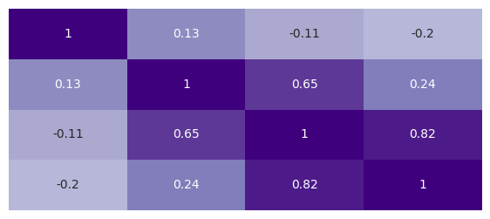
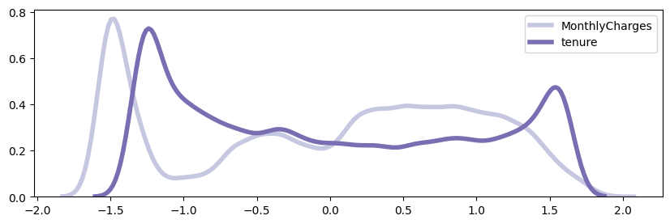
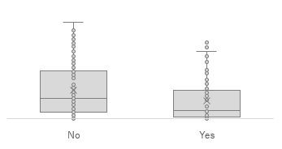
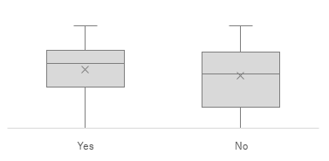
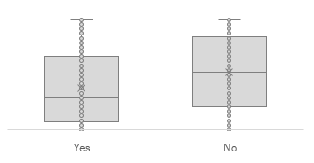
Numerical variables | heatmap, distributions and boxplots
EXPLORATORY DATA ANALYSIS
WIP
Correlation Matrix Heatmap
Distribution Graph
Churn
Monthly
Total Charge
Tenure
Churn
Monthly
Total Charge
Tenure
Box plot | by feature
Tenure
Monthly
Total Charge
Churn
17

